Slide 1
Comparative literature
Faculty of Arts
Year 2
Shaymaa A. Shahine

Slide 2
Codes of Conduct
Phones are not allowed
Start 12 to 1.30 p.m.
Doors closes 12.10 p.m.
What is in it for you? Listening, Reading and Critical thinking
Volunteers for Reflection Tree
Question Bank

Slide 3
William Words Worth
Second language acquisition
Kite Runner by Khaled Hosseini
Quraan
تراب الماس
لأحمد مراد
Pygmalion
By Bernard Shaw
أدهم صبري
ظل الأفعي ليوسف زيدان
Post colonial age
سيدتي الجميلة لفؤاد المهندس وشويكار
Darwin’s theory
بجماليون لتوفيق الحكيم
تراب الماس فيلم لأسر ياسين
Planet of Apes
TESOL
Bible
Wide borders almost not defined
Managerial quality
MBA
Don Juan
بجماليون لتوفيق الحكيم
Stonning of Soraya
A Thousand Splendid Suns by Khaled Hosseini
USA Wars
Pygmalion by Bernard Shaw
Old Testament

Slide 4
What is Comparative Literature

Slide 5
The word 'comparative' derived from Latin comparativus, from comparare
It is an observation or judgment of similarities or dissimilarities between two or more branches of science or subjects of study
Linguistic boundaries
National/ cultural boundaries
Genre (other arts forms film, drama, the visual arts, music, and new media)
Discipline boundaries explore literature with history, philosophy, politics, literary theory,
Translation studies: Why do some texts get translated and others not, for example? And how have the practice and theory of translation changed over time?
Simply, it is an interdisciplinary framework, a transnational and cross-cultural perspective.
In fact all great writings look to their own times and also look forward and backward. The process of comparison is a natural function of the reason. Even in our everyday life

Slide 6
Comparative Literature
World literature: deals generally with the literature that has received a consensus on its greatness, because of being chosen by the time
General Literature: is used to mark the course and publications of foreign literatures through the English translation, which are difficult to be classified under any title of literary studies, which sometimes refer to the literary trends or problems and sometimes to the theories of general interest or aesthetics
International studies
Cultural studies
National literature

Slide 7
World literature
Masterpieces
General Literature
Modernism in Europe
Cultural Literature
USA Canada / Egypt Morroco
National literature
USA India Russia Egypt Britain Canada Brazil Spain Morroco

Slide 8
When it first appeared

Slide 9
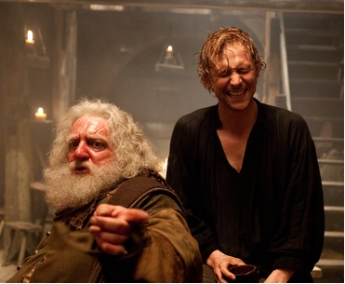
comparative as an adjective was firstly used by Shakespeare in his play King Henry IV, Part I
In 1597
Falstaff's uttered to Hal, Prince of Wales: “…the most comparative, rascalliest, sweet young prince."

Slide 10
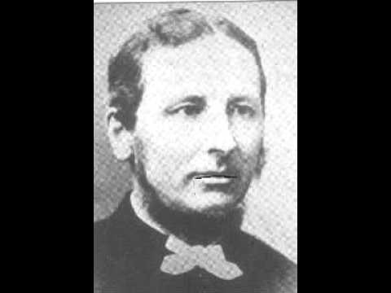
In 1598
Francis Meres used the term as adjective in the section titled "A Comparative Discourse of Our English Poets with the Greek, Latin and Italian Poets
it is the first article of studies of comparative literature. Then

Slide 11
Don’t Forget
Wrap up
Reflection Tree
Question Bank

Slide 12
References
Elmas Sahin. On Comparative Literature. International Journal of Literature and Arts. Special Issue: World Literature, Comparative Literature and (Comparative) Cultural Studies. Vol. 4, No. 1-1, 2016, pp. 5-12. doi: 10.11648/j.ijla.s.2016040101.12
Haun Saussy, ‘Comparative Literature?’, PMLA 2003, 118(2): 336-41 (336, 340). xl Bernheimer, Comparative Literature in the Age of Multiculturalism, p. 12.
Ferris, David, ‘Indiscipline’, in Comparative Literature in the Age of Globalization, edited by Haun Saussy (Baltimore: Johns Hopkins University Press, 2006), pp. 78-99 (p. 91).
R. A. Jelliffe, ‘An Experiment in Comparative Literature’, College English 9 (1947) 2: 85-87 (p. 86).
Steiner, George, ‘What Is Comparative Literature?’, Comparative Criticism, 18 (1996), 157-71 (p. 436).
René Wellek, ‘The Crisis of Comparative Literature’, in Concepts of Criticism, edited by Stephen G. Nichols (New Haven & London: Yale University Press, 1963), pp. 282-295 (p. 290).

